Slide 1
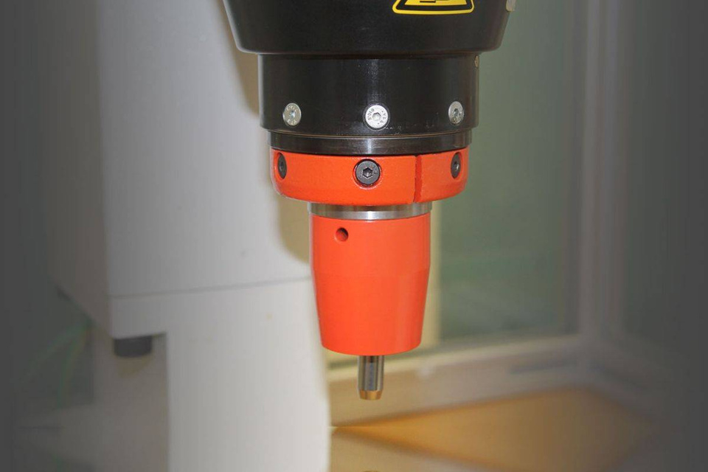

ORBITAL RIVETING
ALL- AROUND
WELL JOINED
Orbital Riveting in Cold Forming:
A Precision Joining Process for High-Efficiency Manufacturing
Orbital riveting isagood alternativeto radial riveting in cases of hollow rivets or forming tubes and sleeve like parts.
In the field of cold forming, mechanical joining technologies are essential for achieving durable, high-performance assemblies without thermal input. One such method is orbital riveting, a process that enables permanent mechanical fastening through localized malleable deformation of the rivet material such as steel, aluminum, copper, gold and many more.
As it applies force, the rivet is gradually shaped into its final form. The distinctive orbital motion of the tool gives orbital riveting its name.
In contrast, radial riveting follows a rosette-shaped path that moves across the center of the rivet, offering a different approach to material flow and deformation.
Orbital riveting is particularly well-suited for high-speed production lines, where short cycle times and lower forming forces are essential. Compared to traditional pressing methods, it not only reduces mechanical stress but also significantly cuts down on noise emissions—making it a quieter, more energy-efficient alternative.
The orbital riveting process employs a conically inclined, rotating forming tool that applies a controlled force to the rivet. As the forming tool orbits around the rivet axis, it incrementally deforms the riveting pin in a circular path, forming a secure joint. This orbital motion—characterized by a precessing, wobble-like movement—minimizes axial force requirements and distributes forming energy more efficiently than conventional pressing.

Slide 2
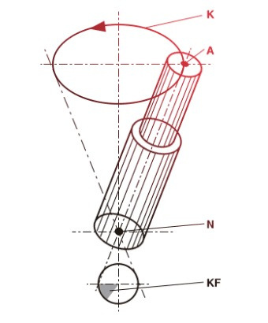
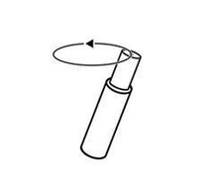
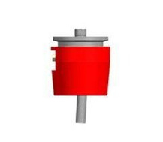
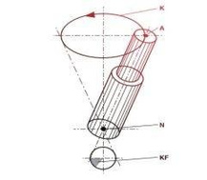
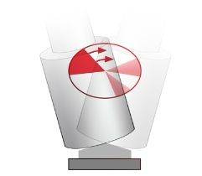
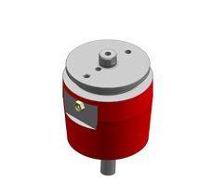
ORBITAL RIVETING
Orbital riveting is different to the radial riveting procedure and is much smoother than impact pressing.
Controlling the flow of material with the orbital process is limited. There is a constant lateral force present while forming, which requires for the work piece to be supported quite well. The circular movement of the forming tool creates a crescent-shape like contact area on the rivet which results in some surface friction. The forming is effected around the riveting head.
Caption: One riveting die A rotates in a circular path K at approx. 1000 rpm in such a way that the longitudinal axis of the riveting die intersects the rivet at point N. Deformation of the rivet is therefore carried out in concentric paths around the centre of the rivet
A = forming tool axis
K = Path of forming tool
N = Forming surface @ constant angl
KF = contact surface or area

Slide 3
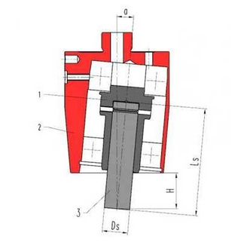
FORMING TOOLS AND PROFILES ORBITAL RIVETING
The free height (H) and the tool length (Ls) result from the two diﬀerent angles of inclination available (3° or 5°) of the orbital.
Legend orbital riveting head:
1 = tool holder
2 = orbital head-housing
3 = riveting tool
HIGH-QUALITY FORMING TOOLS - MANUFACTURED IN- HOUSE
Models
Process
Radius
Rp
Tool- length
Ls
Free height
H
Shank diam.
-Ø Ds
Angle of inclination
α
EN/ENE 20, 20R, 35
EO 30
Orbital
84
116
54
54
28
60
28
28
20
20
10
10
5°
3°
5°
3°
EO 03, 15

Slide 4
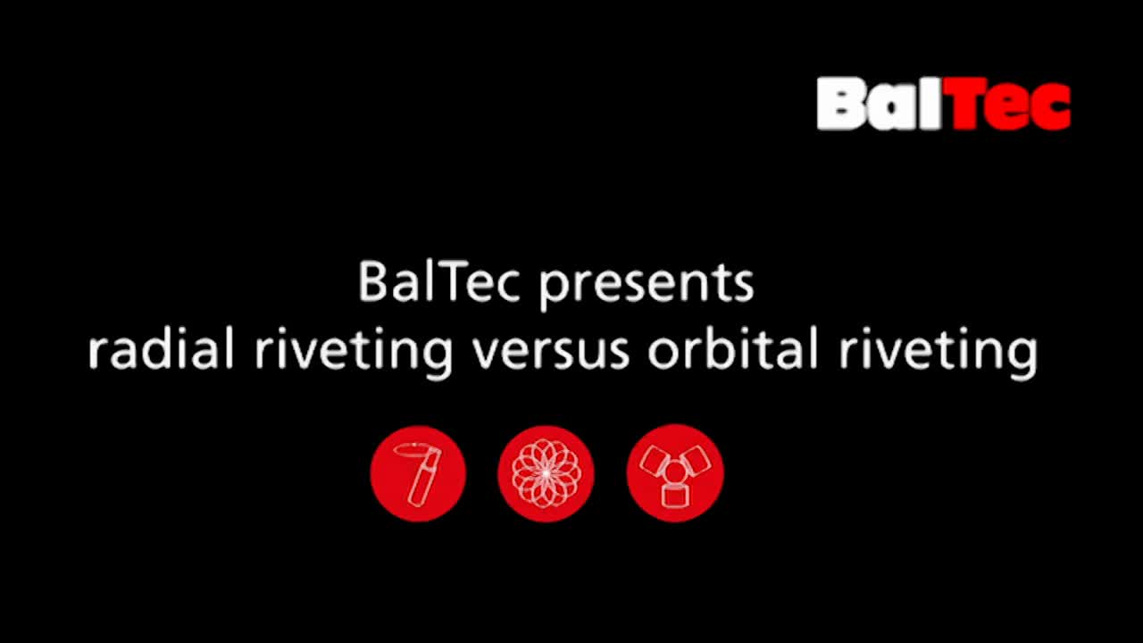
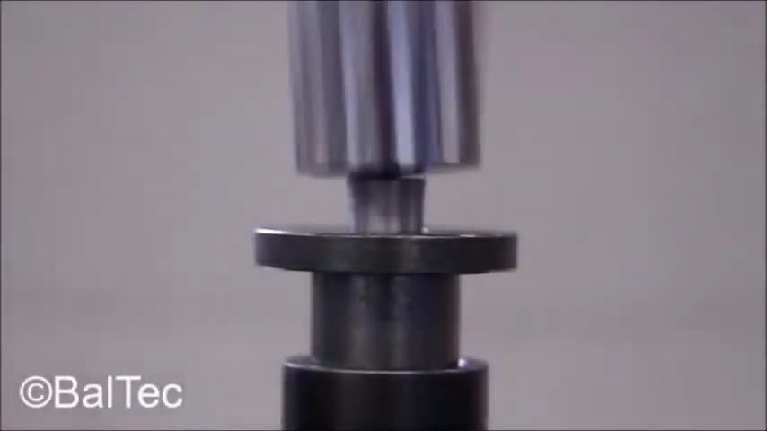
On the following video clips you can recognize that the riveting tool is rotating – not so in radial riveting.
Example of orbital riveting with a flat tool. The rotation of the forming tool is clearly visible.

Slide 5
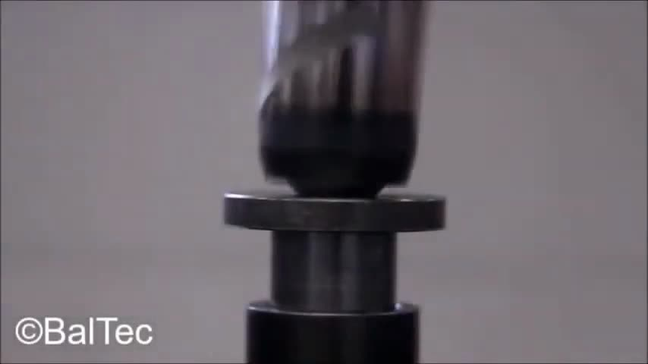
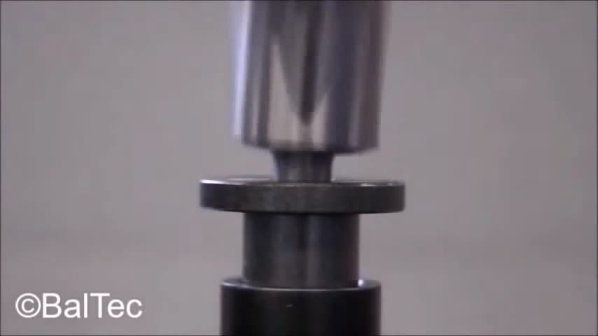
Orbital riveting with a flat cambered tool.
This video shows an orbital riveting process with a high cambered tool.

