Slide 1
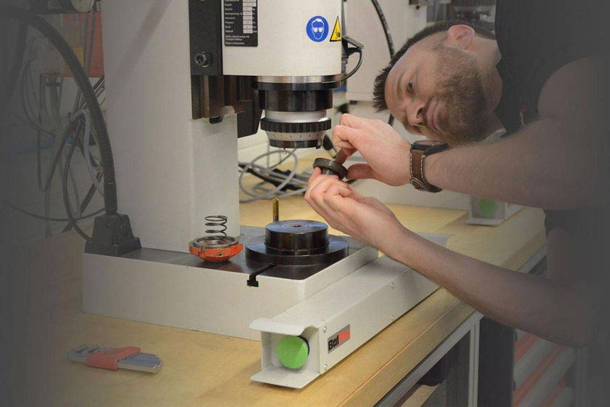

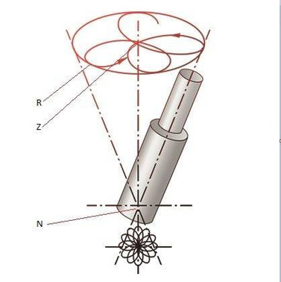
RADIAL RIVETING TECHNOLOGY
THE GENTLE FORMING PROCESS
Basically, the application, quality speciﬁcations, and required process times deﬁne the cold forming method.
Radial riveting processes are well known for their gentle
In most cases, however, where high-quality joints are demanded or like critical applications, the radial riveting technology is the appropriate procedure as it is a delicate process, which requires little force to displace the necessary material. As a result, high quality is obtained.
approach to material in the cold forming process.
/
Excellent surface structure of the closing head
With the radial riveting process, the tool itself does not rotate. The friction between tool and workpiece is thus at a minimum. The result is an excellent surface structure.
Low workpiece loading
Forming even of brittle parts like Bakelite or ceramic parts is possible.
Lateral forces are negligible. Supporting the workpiece is simple, and clamping is usually unnecessary.
Tangential riveting
It is a process between radial and orbital riveting. The pattern is like the orbital process but with some beneﬁts of the radial process. The path of the riveting peen does not lead through the center. This riveting is used in special cases.
Caption: Each rosette pattern R runs through the centre Z. The longitudinal axis of the riveting die still intersects the rivet at point N. The rivet is deformed in three directions. Radially outwards, radially inwards, and overlying also tangentially (circular).

Slide 2
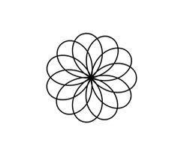
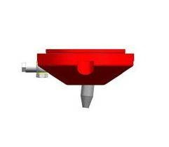
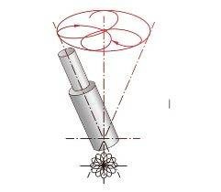
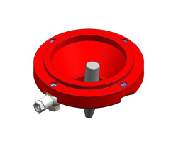
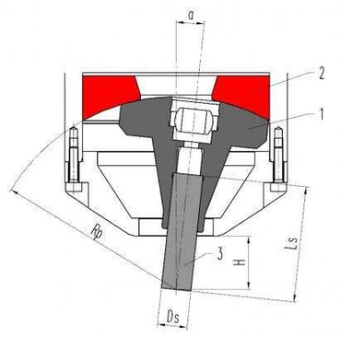
FORMING TOOLS AND PROFILES RADIAL RIVETING
All BalTec radial riveting machines are ﬁtted as standard with tool holder and pressure cup. The tool length (Ls) and the radius of the holder (Rp) result from your desired free height (H).
Legend radial riveting head:
1 = tool holder
2 = pressure cup
3 = riveting tool

Slide 3
HIGH-QUALITY FORMING TOOLS - MANUFACTURED IN- HOUSE
Radial riveting Models RN/RNE 081, 151, 181, 231, ER/ET 03, 15
Radius
Rp
65
80
100
120
132
Tool-
length Ls
39
54
74
94
106
Free
height H
18
33
53
73
85
Shank
Ø Ds
10
10
10
10
10
Angle of
inclination α
6° 02'
4° 47'
3° 44'
3° 04'
2° 46'
Radial riveting Models RN/RNE 281, 331, 381, 431, ER/ET 30, 50
Radius
Rp
100
116
132
148
170
191
240
Tool-
length Ls
68
84
100
116
138
159
208
Free
height H
28
44
60
76
98
119
168
Shank
Ø Ds
20
20
20
20
20
20
20
Angle of
inclination α
5 ° 37'
4° 47'
4° 10'
3° 41'
3° 10'
2° 49'
2° 13'
Radial riveting Model RN/RNE 481
Radius
Rp
148
196
240
290
Tool-
length Ls
100
148
192
242
Free
height H
45
93
137
187
Shank
Ø Ds
30
30
30
30
Angle of
inclination α
6° 15'
4° 38'
3° 45'
3° 04'
Please note: The riveting performances speciﬁed in the BalTec product datasheets and operating manuals always refer to the riveting form tool with the shortest length for best performance. If a longer riveting tool is needed, then in consequence the forming angle as well as the forming eﬃciency is decreasing.
Only trials will deﬁne the right machine size.

Slide 4
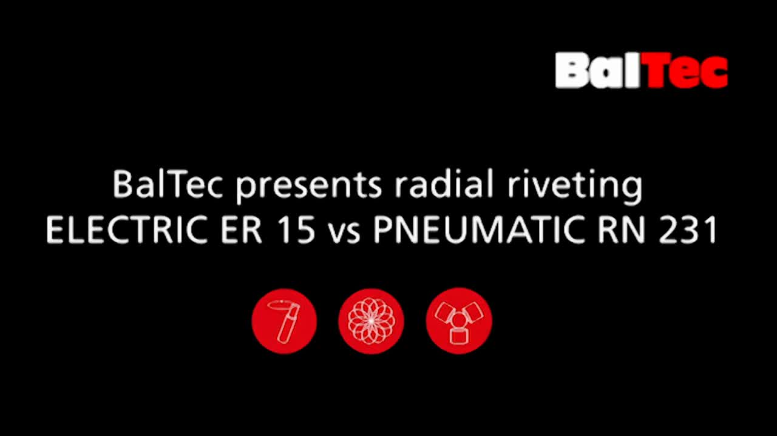
Eye-catching: The diﬀerences in speed show one of the advantages of the ELECTRIC over conventional devices.
ELECTRIC ER 15 vs PNEUMATIC RN 231 | Rebitadeira ELECTRIC ER15 vs Rebitadeira pneumá

Slide 5
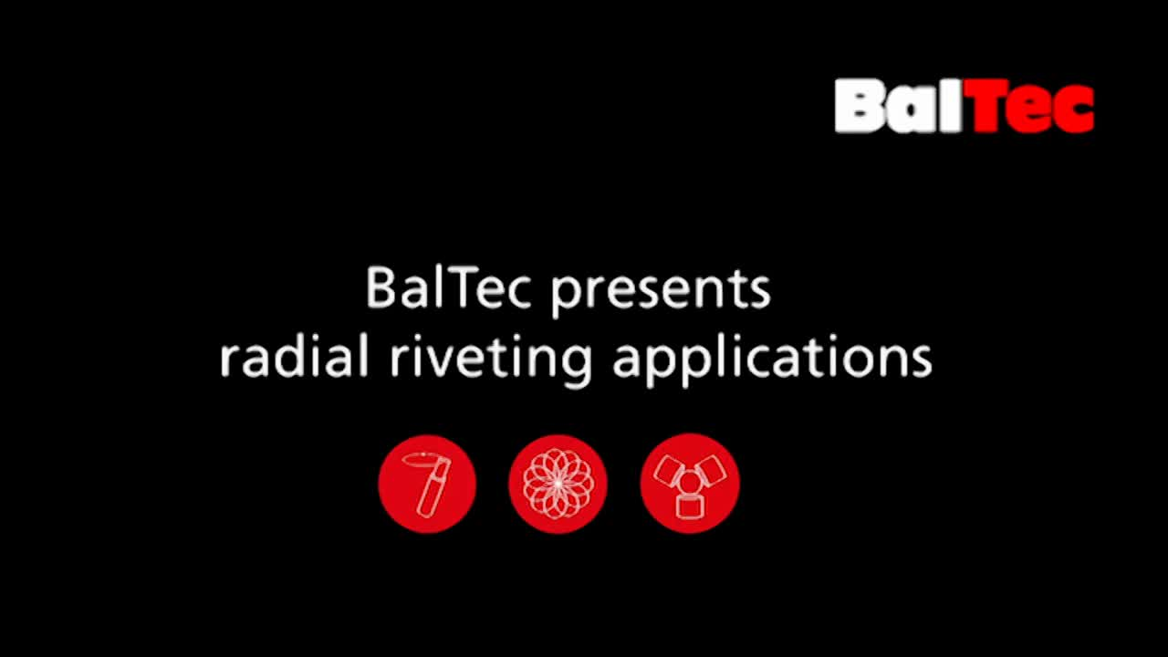
Diversity at its best: a variety of radial riveting sequences.
Radial riveting applications by BalTec | Aplicações com Rebitadeira Radial BalTec
Radial riveting applications (/en/applications)

Slide 6
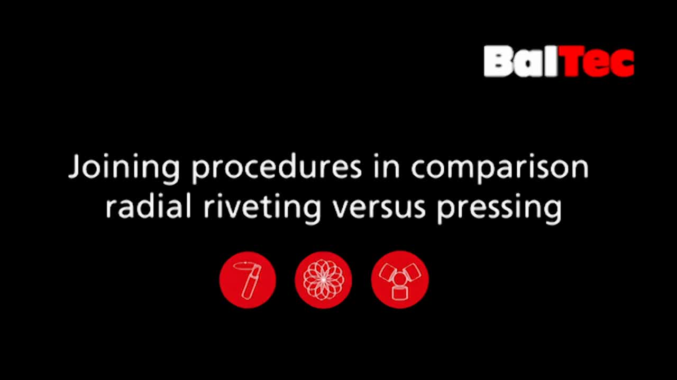
Radial riveting vs pressing by BalTec | Comparação entre rebitagem radial versus prensagem
Radial riveting vs. pressing (/en/technologies/form-pressing)

