Slide 1
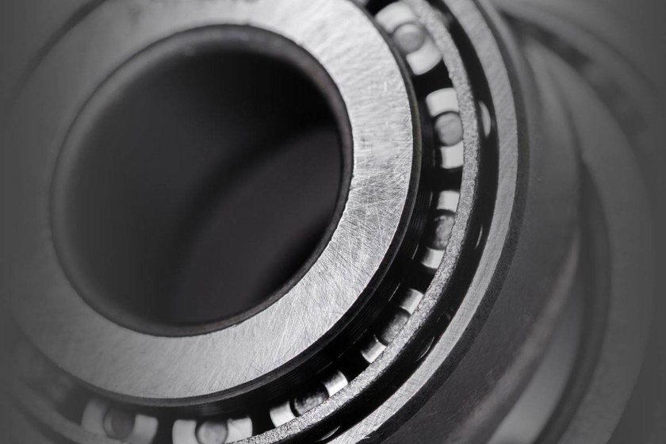


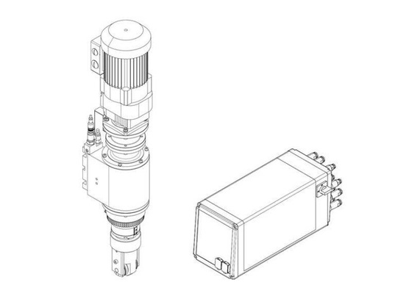
ROLLER FORMING
ROLLER FORMING WITH FINESSE
The forming process is achieved through the form rollers, which are mounted to the roll forming head.
The roller forming or burnishing technique reshapes the workpiece by means of a gentle rotational movement, inward or outward.
/
This head in turn is driven by the machine at a controlled linear feed rate as well as the optimal rotational speed.
Forming thin-wall parts is possible since the downward force is minimal. Collapsing or bulging of material can pretty much be eliminated through that loosing of material height. The rollers form the material into the desired shape. Creating a seal is possible as the final form is well controllable.
Roll forming heads and profile rollers are design application-specific. For each specific application, BalTec will manufacture an individual roller head. Workpieces and their dimensions define the design and execution regarding roller head design, such as the number of rollers, rotation speed and the form roller geometry. If needed, one can incorporate a pressure pad into the roller forming head.

Slide 2
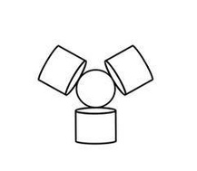
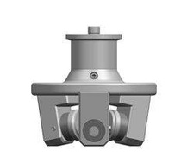
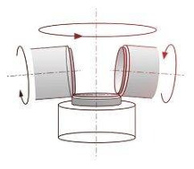
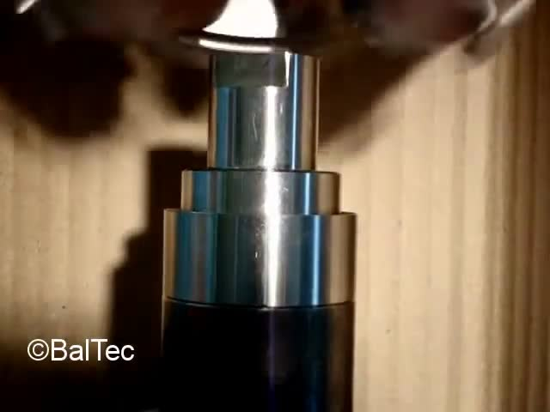
The edge of the lower tube is formed.
Pressure sensor housing
INDIVIDUAL ROLLER HEADS
For every roller forming item, there is an individual roller application necessary. The material will either be rolled inwardly or outwardly, depending on the parts and speciﬁcations. Due to many years of experience and the constantly changing customer needs, we have diversiﬁed and perfectioned the applications over time. We supply customized roller forming heads with two to ﬁve rolls that deform the material.

Slide 3
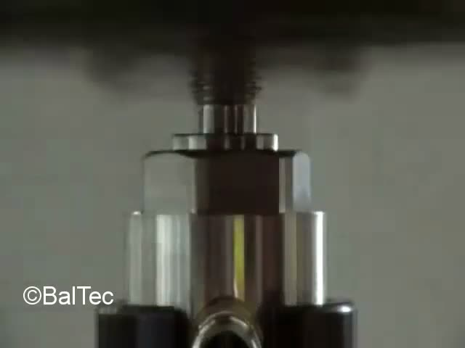
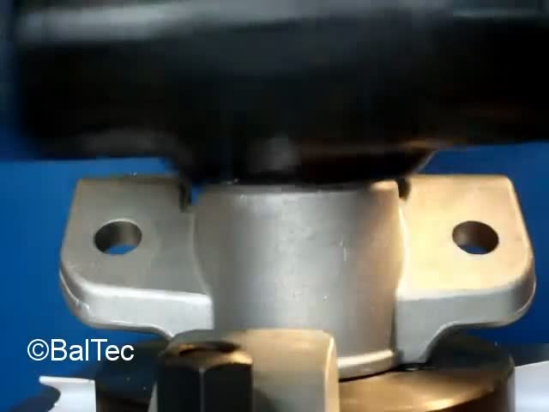
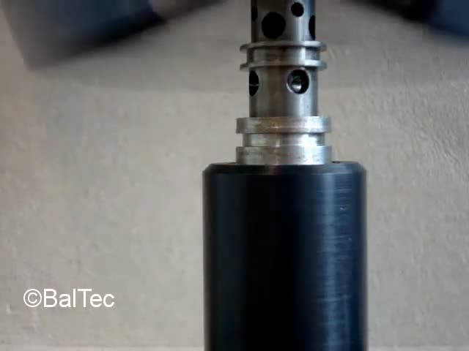
Housing coupling
Shear mount assy
Hydraulic valve

